Slide 1
Piping And Instrumentation Diagram

Slide 2
What is P&ID?
A piping and instrumentation diagram, or P&ID, shows the piping and related components of a physical process flow. It’s most commonly used in the engineering field.
P&IDS are foundational to the maintenance and modification of the process that it graphically represents. At the design stage, the diagram also provides the basis for the development of system control schemes, like Hazard and Operability Study (HAZOP).
P&IDs are a schematic illustration of the functional relationship of piping, instrumentation and system equipment components used in the field of instrumentation and control or automation.

Slide 3
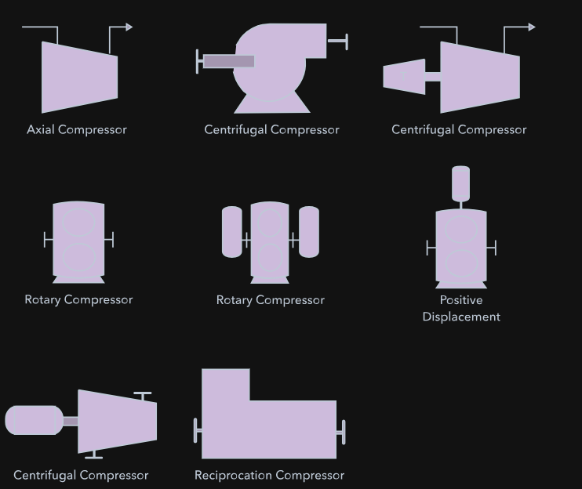
Equipment
Equipment is comprised of miscellaneous P&ID units that don't fit into the other categories. This group includes hardware like compressors, conveyors, motors, turbines, vacuums, and other mechanical devices.

Slide 4
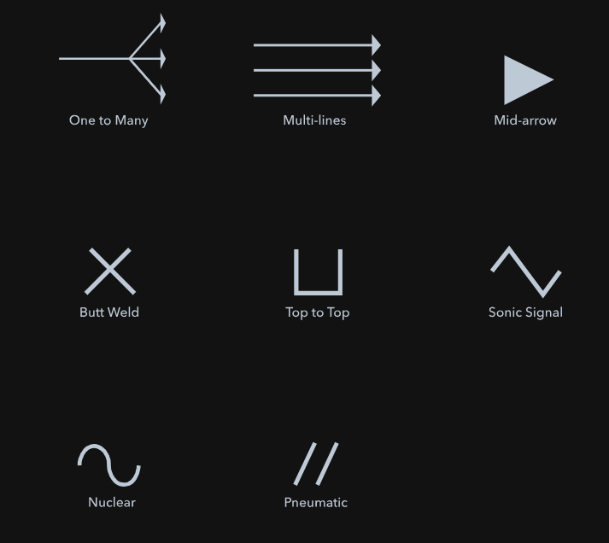
Piping
A pipe is a tube that transports fluid substances. Piping can be made of various materials, including metal and plastic. The piping group is made up of one-to-many pipes, multi-line pipes, separators, and other types of piping devices.

Slide 5
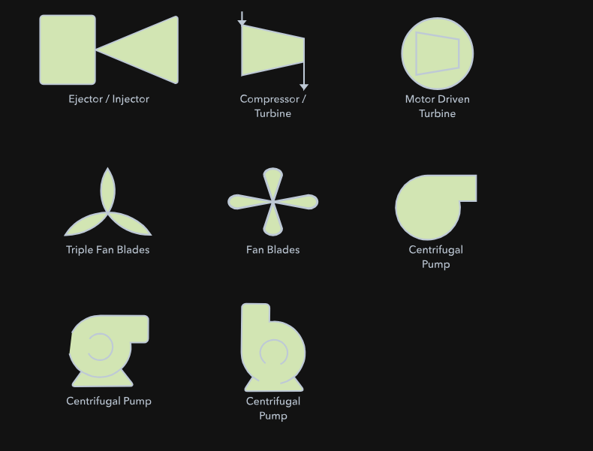
Pumps
A pump is a device that uses suction or pressure to raise, compress, or move fluids in and out of other objects. This section is comprised of both pumps and fans.

Slide 6
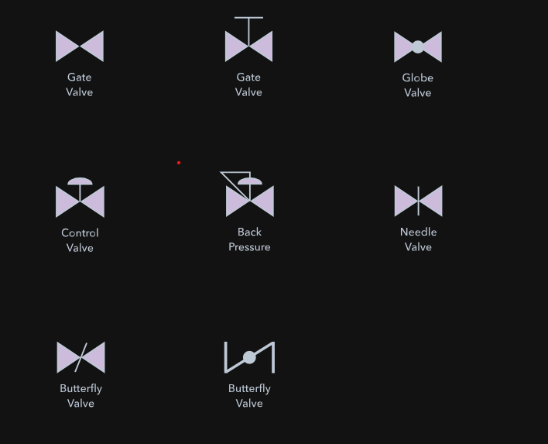
Valves
A valve regulates, directs, or controls the flow of a fluid by opening, closing, or partially obstructing passageways in a piping system. This category includes rotameters, orifices, and other types of valves.

Slide 7
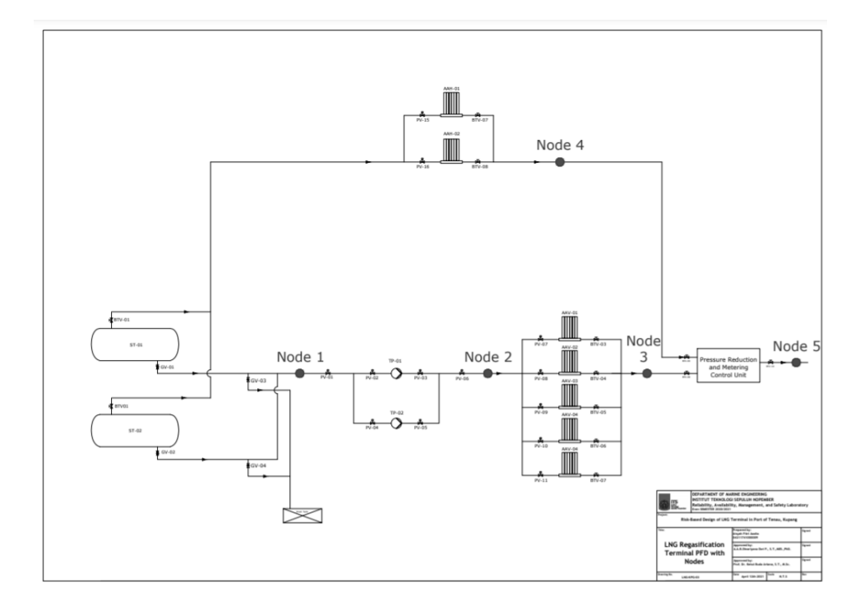
P and ID in LNG terminal
Process flow diagram (PFD) is use to show the general flow of the LNG regasification terminal. PFD only include major equipment and exclude minor details such as instrumentations.

Slide 8
In starting step of hazard identification, the system is divided into 5 nodes based on the function and the severity of the hazard.
Node 1- process of containing LNG in ISO LNG Tank and LNG unloading.
Node 2-process of LNG transfer to ambient air vaporizers.
Node 3-process of regasification of LNG back to natural gas.
Node 4-process of Boil Off Gas Treatment
Node 5-process of transferring natural gas to pressure reduction and metering unit through pipes.
The results of HAZOP studies indicated that the potential fire hazard that occurs LNG regasification terminal are gas release that can lead to fire. Afterwards, based on the comment and recommendation in HAZOP sheets, additional safeguards will be added to the previous design resulting P&ID as in figure 5, figure 6, and figure 7

Slide 9
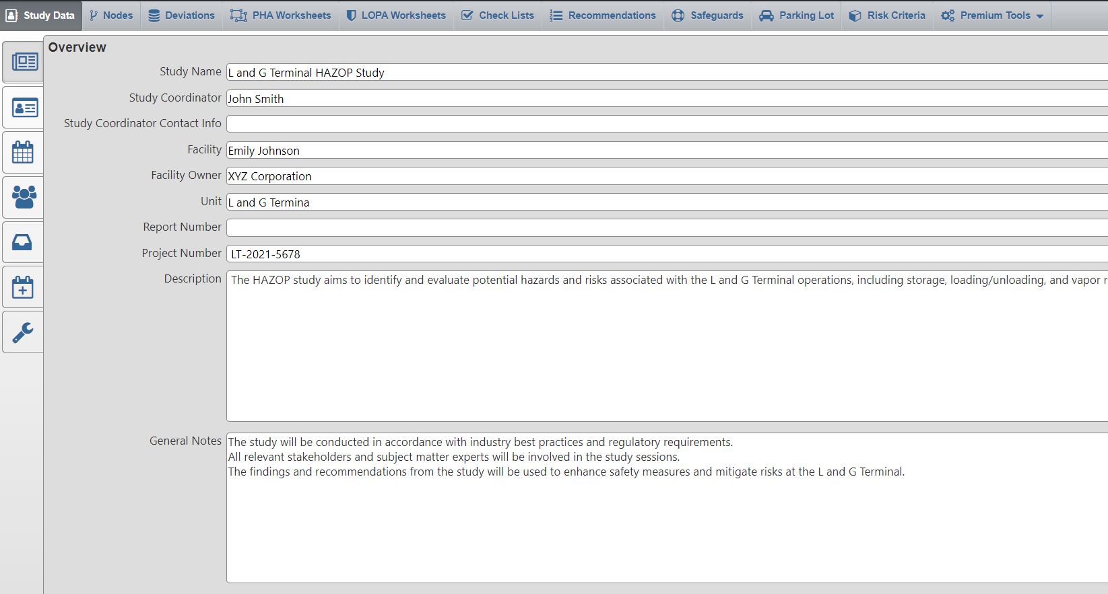
HAZOP Report- LNG terminal

Slide 10
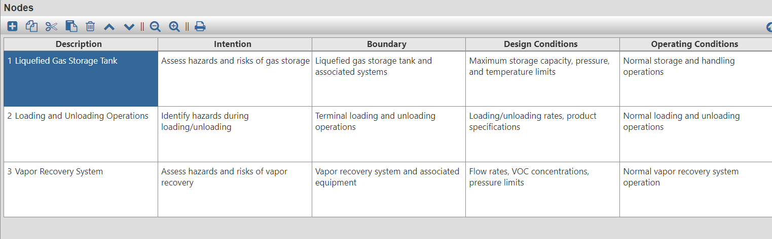
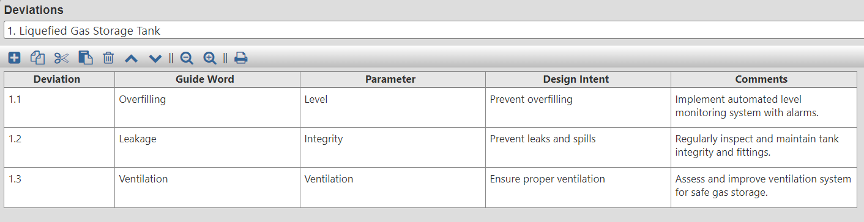

Slide 11
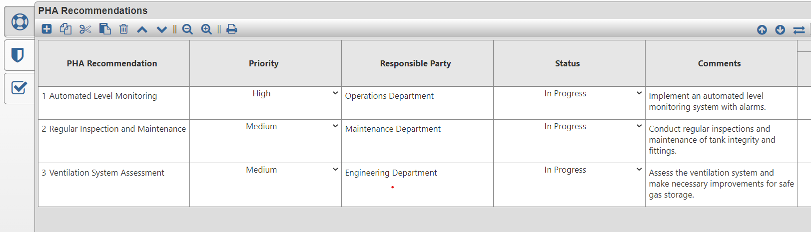

Slide 12
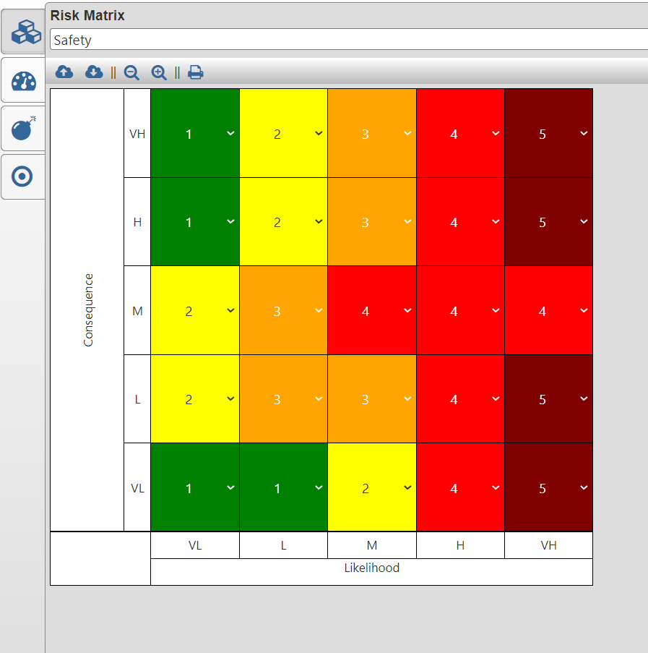
Risk Matrix

Slide 13
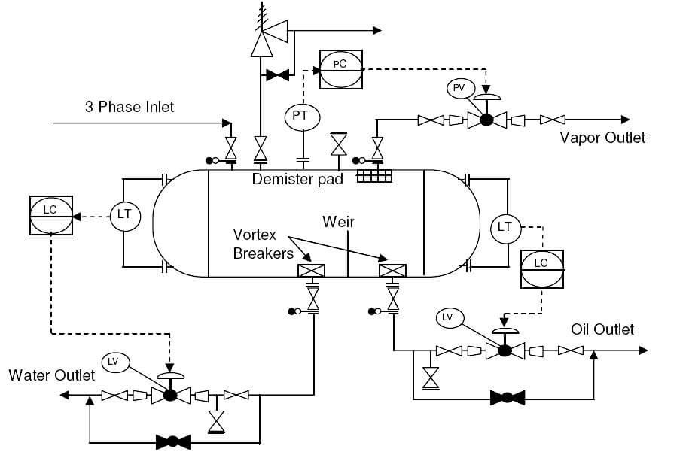
P and ID in Oil Storage plant

Slide 14
Crude Oil Treatment Process
There is initial separation equipment in the crude oil treatment process. It functions as a three-phase separator, separating the majority of free water from the crude oil.
The Heater-Treater separator is the second stage of separation in the treatment process. It combines a three-phase separator with a heating system using fuel gas.
The Electrostatic-Desalter is the final stage of water and salt removal in the crude oil treatment process. It utilizes an electric field to promote the coalescence of water.
Fresh well water is injected before the Electrostatic-Desalter to achieve the final dilution required for salt removal and produce treated oil
The treatment of crude oil offers several benefits. It produces treated oil with reduced water and salt content, improving its quality for further processing and utilization.

Slide 15
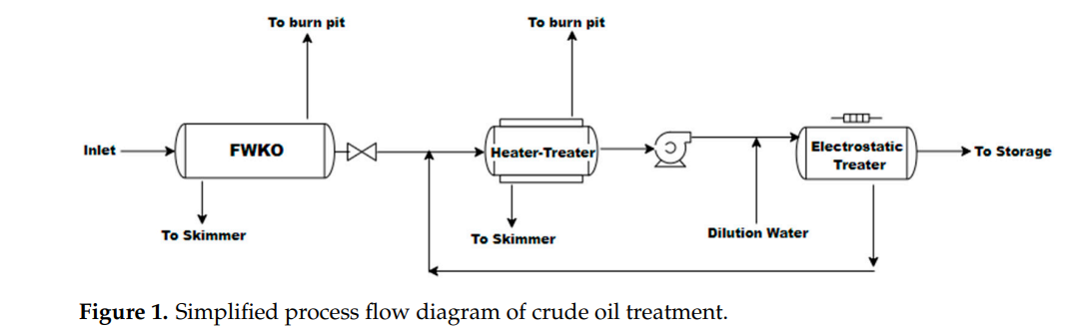
Crude Oil Treatment Process

Slide 16
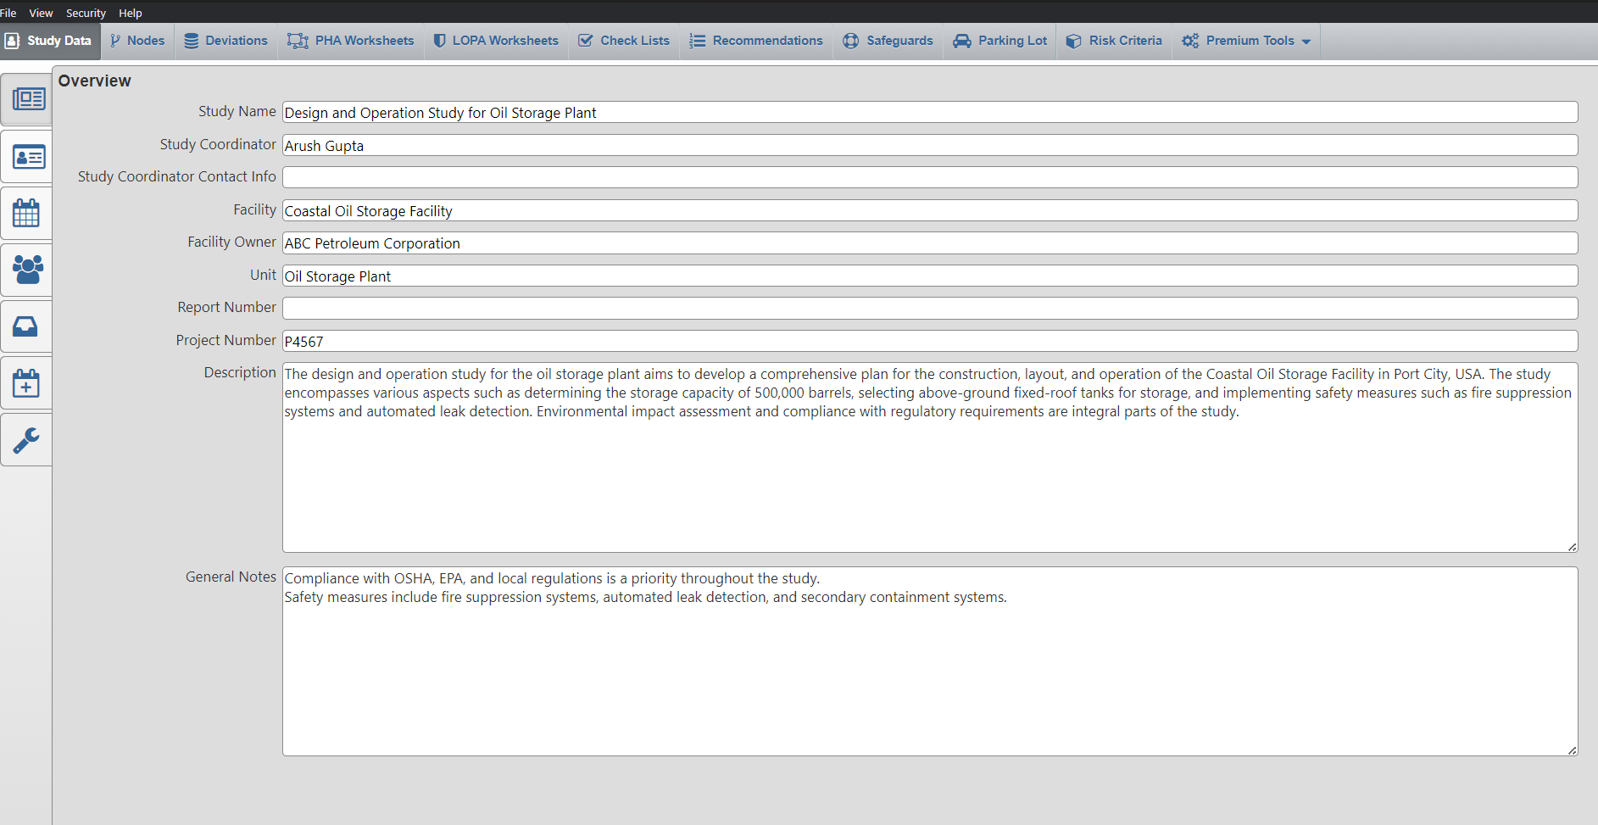
HAZOP Report- Oil Storage plant

Slide 17
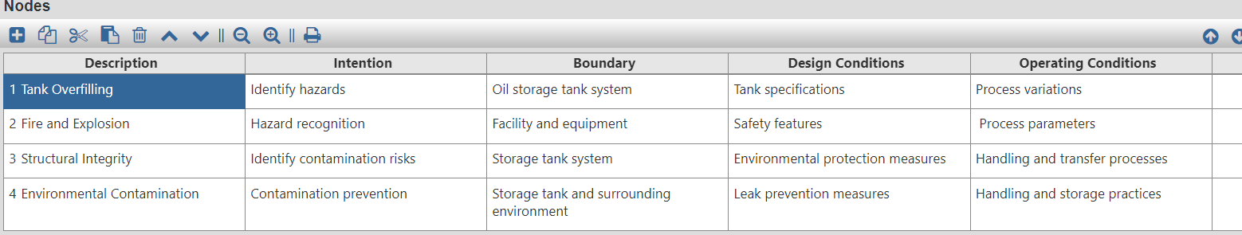
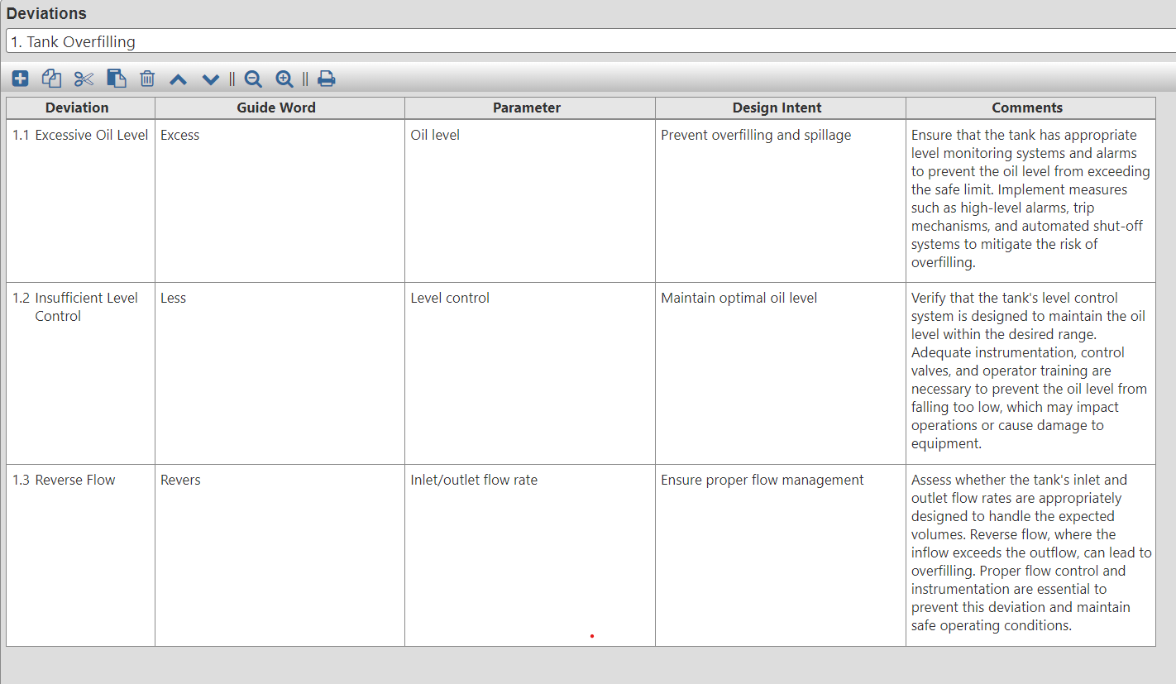

Slide 18
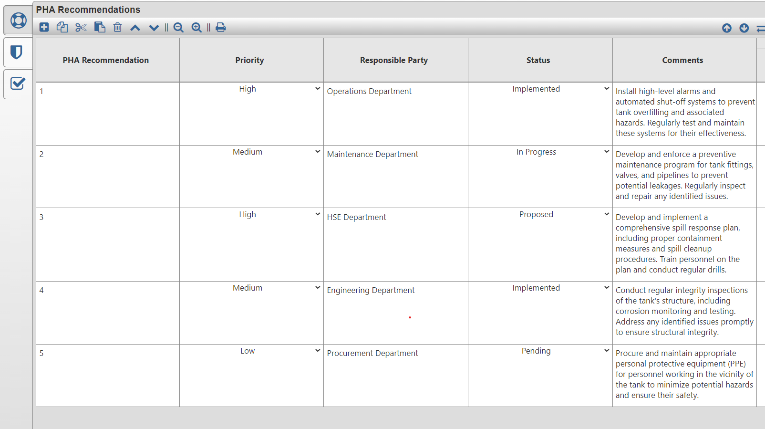

Slide 19
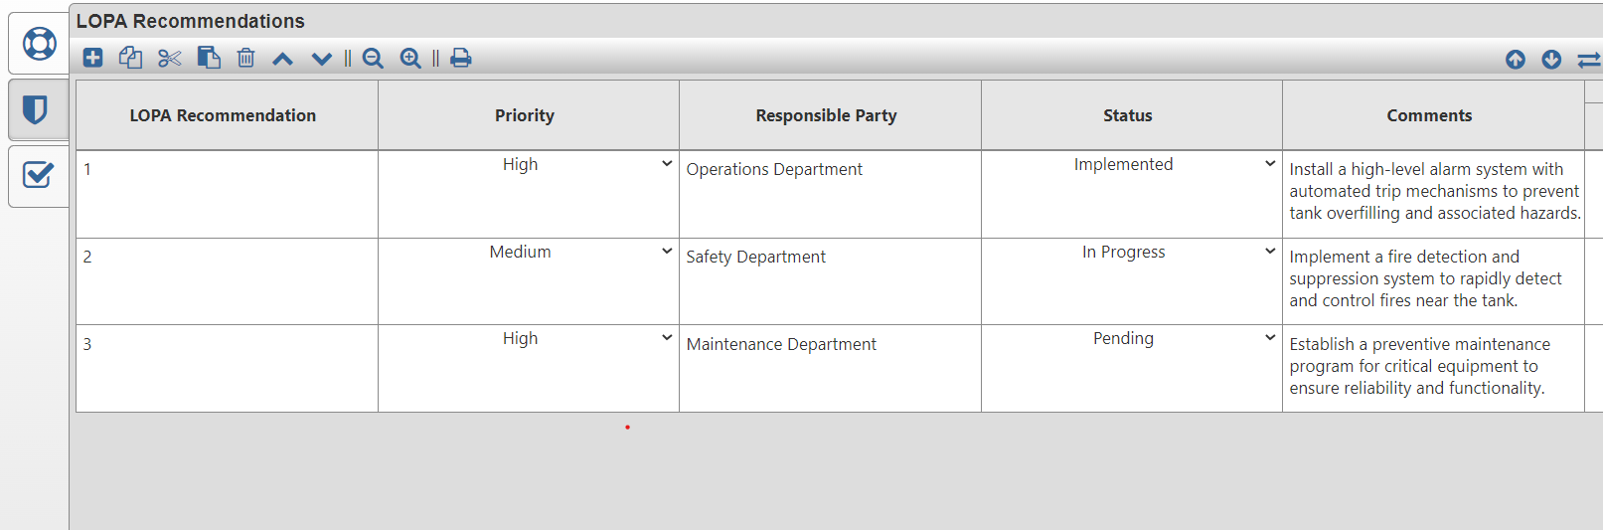
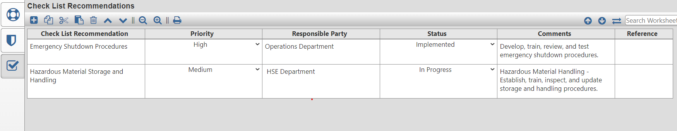

Slide 20
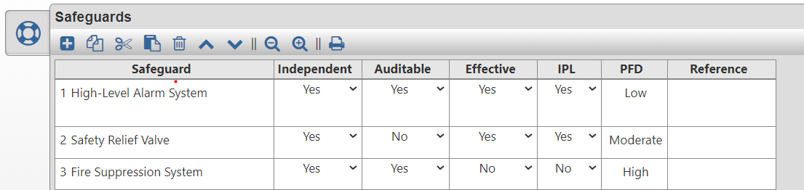
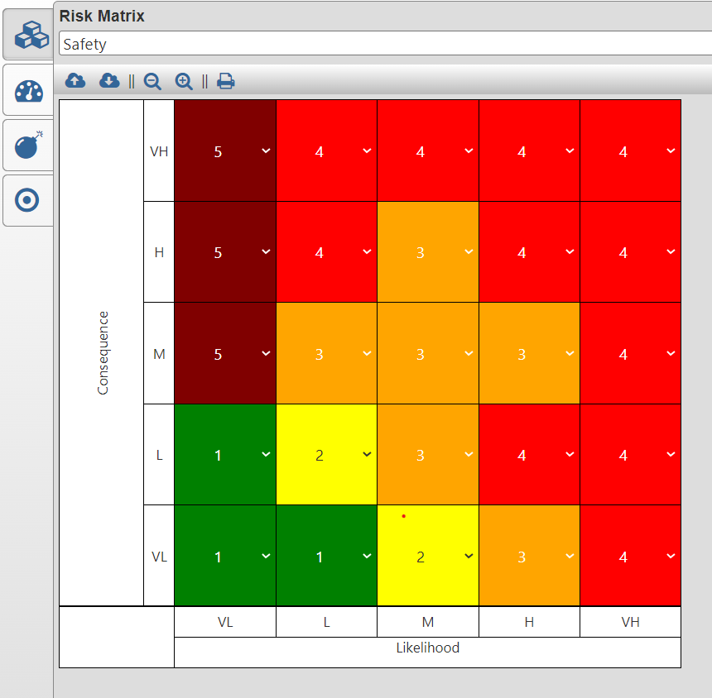

Slide 21
P and ID in Refinery
The analysis of risk associated with hazard is the main aspect of oil industry. Risk assessment or risk analysis is carried out throughout the use of many suitable methods of study.
The method involves Qualitative and Quantitative Risk Assessment. Qualitative or Historical risk analysis is preliminary risk assessment, while Quantitative risk analysis i.e. HAZOP is used in severe cases in various industries.
A petroleum refinery provides the most needed fuels for everyday use for industrial, commercial and domestic purposes. Processing crude oil in refinery requires large percentage of oil which is contaminated and requires some level of treatment.
The main objective is to identify the hazards only related to oily waste water treatment plant. The disposal of waste water from the refinery is the very serious problem in Pakistan. Therefore oily waste water treatment facility should be hazard free before and after treatment.

Slide 22
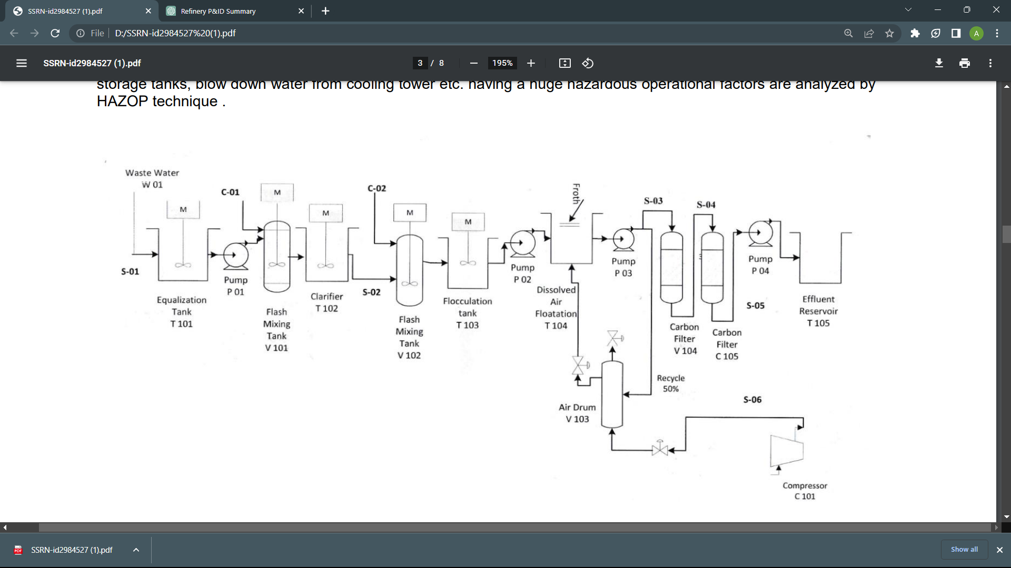
For a safer side with all respect HAZOP study is necessary for all Refineries of Pakistan. The HAZOP study is carried out for safety, reliability and to optimize the instrumentation in the Refinery.

Slide 23
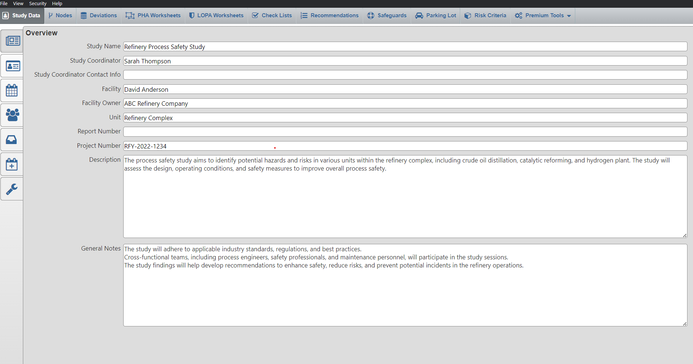
HAZOP Report-Refinery

Slide 24
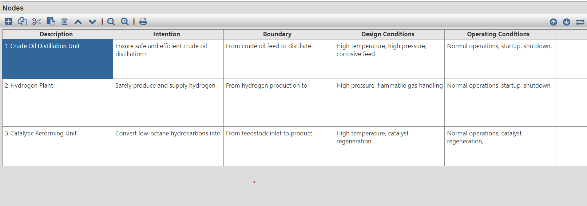
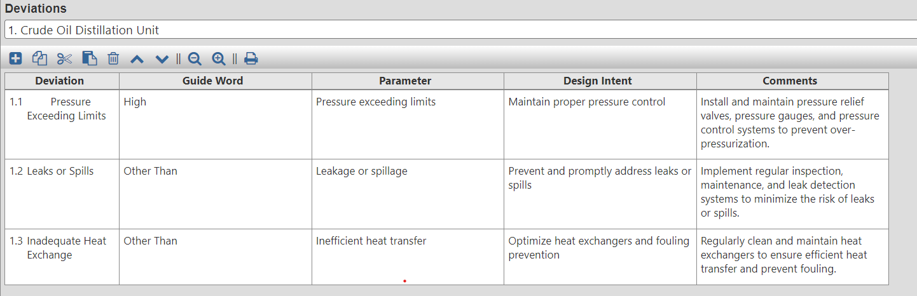

Slide 25
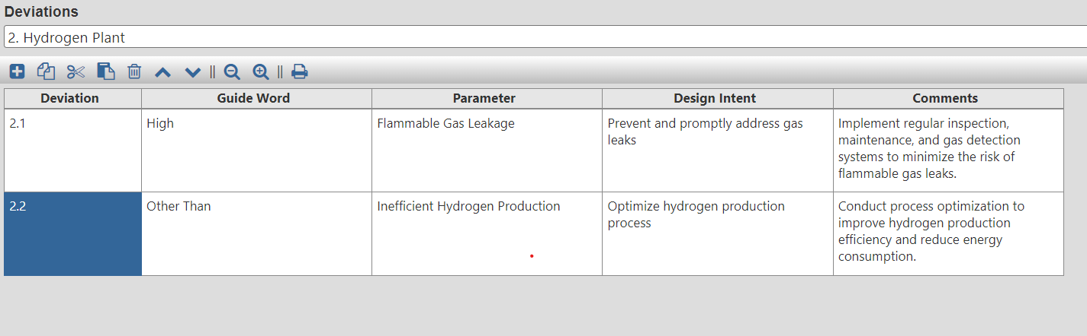
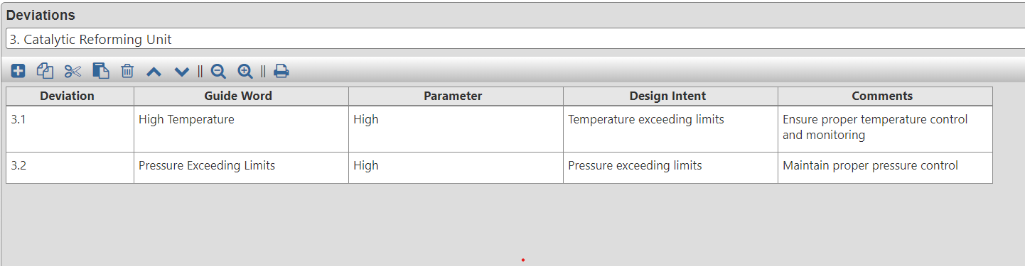

Slide 26
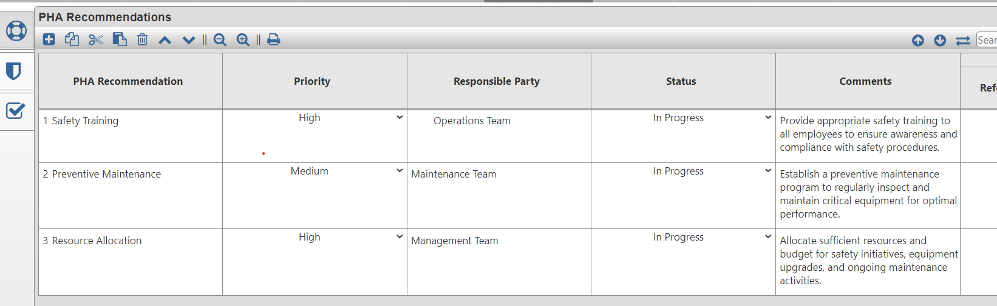
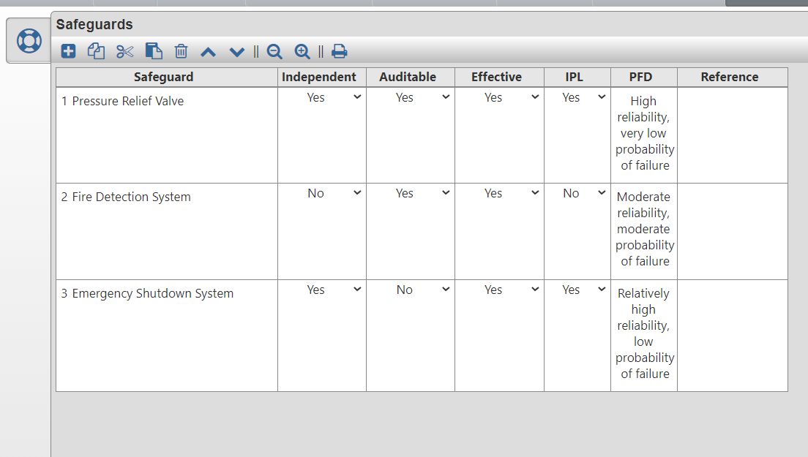

Slide 27
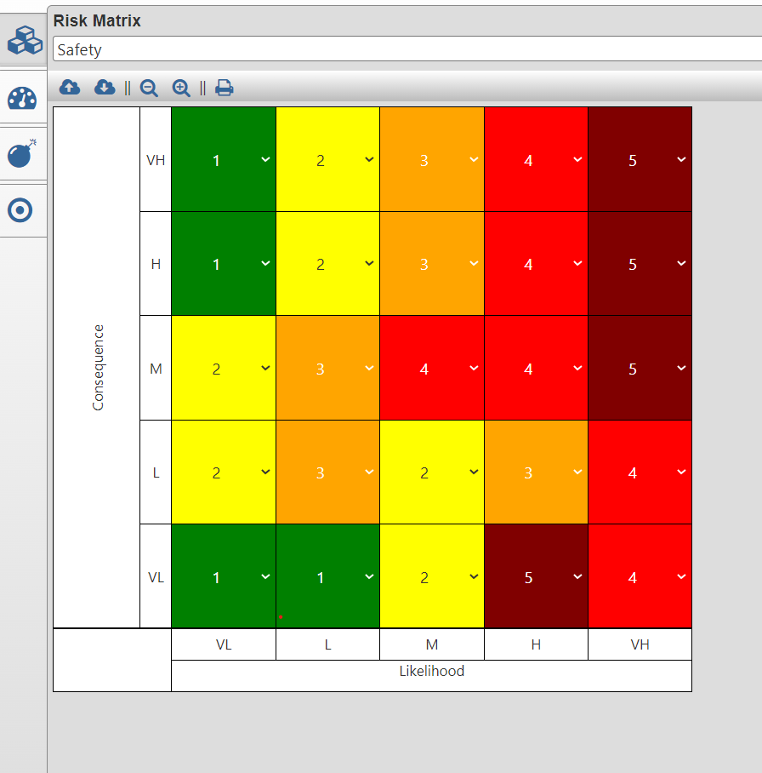
Risk Matrix

Slide 28
What are the limitations of P&ID?
Since P&IDs are graphic representations of processes, they have some inherent limitations. They can’t be relied on as real models, because they aren’t necessarily drawn to scale or geometrically accurate.
There’s also no generally accepted universal standard for them, so they may look different from company to company—or even within the same company—based on internal standards, the type of software system being used, and the preferences of the creator.

Slide 29
Thank you

